Slide 1
Discussion of Luo, Zhou, Zhou – Which Factors Matter in the Pricing Kernel?
Robert Stambaugh

Slide 2
Outline
Which factors matter for pricing?
How can the factor zoo be used to obtain a high Sharpe ratio?
Methodology questions
Final comments

Slide 3
Factor zoo
174 long-short equity portfolios, each based on a stock characteristic
Six groups of characteristics:
Momentum (14)
Value vs. growth (21)
Investment (33)
Profitability (22)
Intangibles (52)
Trading frictions (32)
Also include the excess market return (making 175 factors)
Later add 16 long-short corporate bond portfolios based on bond characteristics

Slide 4
Which factors matter? Many
REP strategy chooses 52 factors on average, fluctuating between 34 and 79
Market factor gets included in 95% of months
Factor importance gauged by an exclusion metric:
Compute out-of-sample (OOS) Sharpe ratio with all 175 factors in the choice set
Exclude a factor, rerun the paper’s REP strategy, compare OOS Sharpe ratios
Factors that, when excluded, reduce OOS Sharpe ratios the most
earnings predictability (14.2% reduction)
market factor (4.2% reduction)
years 6 to 10 return seasonality (2.4% reduction)
24 other factors produce statistically significant reductions when excluded

Slide 5
Non-market factors whose exclusions most matter
Earnings predictability (Francis, LaFond, Olsson, Schipper, 2004, Acct. Rev.)
Std. dev. of forecast error in an AR(1) model for annual earnings per share
We generally find a statistically reliable association between each earnings attribute considered individually and our proxy for the cost of equity; the exceptions (or least consistent relations) are found for predictability and conservatism. … Among the seven attributes we consider, accrual quality is the dominant attribute in terms of cost of equity effects.
From Francis et al. (p. 1006)
Years 6 to 10 return seasonality (Heston & Sadka, 2008, JFE)
E.g., at the end of March in year t, long (short) stocks that performed the best (worst) in the April months of years t-6 through t-10
 | Avg. monthly return (%) | t-statistic
Year 1 | 1.15 | 7.60
Years 2–5 | 0.67 | 5.35
Years 6–10 | 0.68 | 6.15
Years 11–15 | 0.66 | 6.43
Years 16-20 | 0.52 | 4.58
From Table 2 of Heston & Sadka:

Slide 6
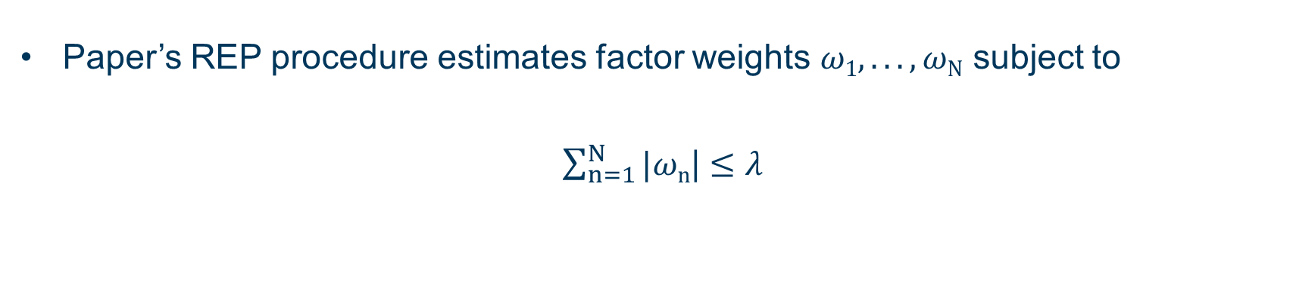
Another gauge of factor importance
Real-time three-factor model
Paper’s REP procedure estimates factor weights $ω1, . . ., ωN$ subject to
$\sum_{n=1}^{N}{|ωn}$| $≤$ $λ$
Take the first three factors to enter with non-zero $ωn$ as $λ$ increases

Slide 7
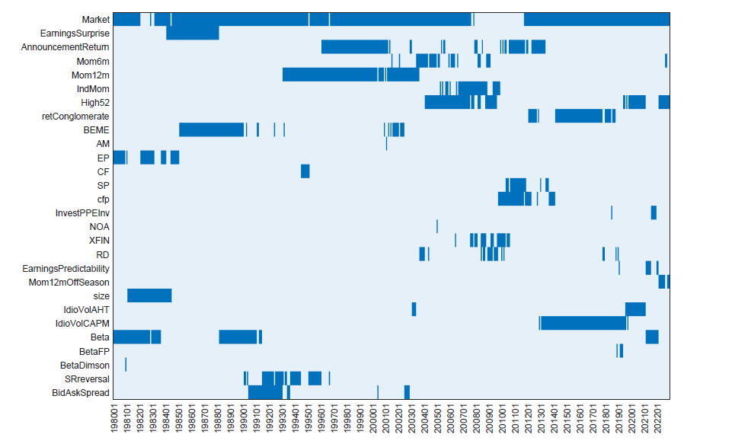
The three selected factors in real time

Slide 8
Questions about factors
Which factors matter for pricing assets?
How can the factor zoo be used to obtain a high Sharpe ratio?

Slide 9







The portfolio with the highest Sharpe ratio prices all assets
$$μ$$
$$μ$$
$$⇔$$
P
assets
$$μP$$
maximum
$$\frac{μ}{σ}$$
$$β$$
with respect to P
$$σ$$

Slide 10
Exploiting the factor zoo: treat it as the asset universe forming P
$$μ$$
$$μ$$
$$⇔$$
P
factors
$$μP$$
maximum
$$\frac{μ}{σ}$$
$$β$$
with respect to P
$$σ$$

Slide 11
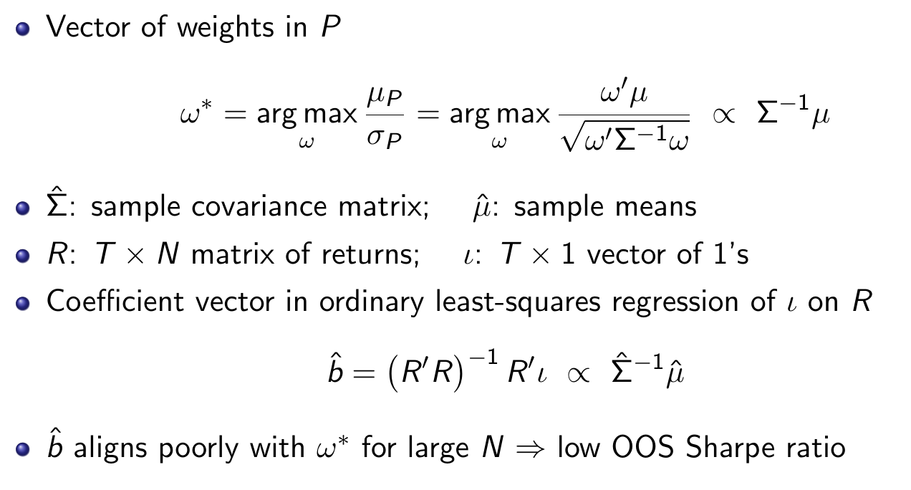
Weights in P

Slide 12
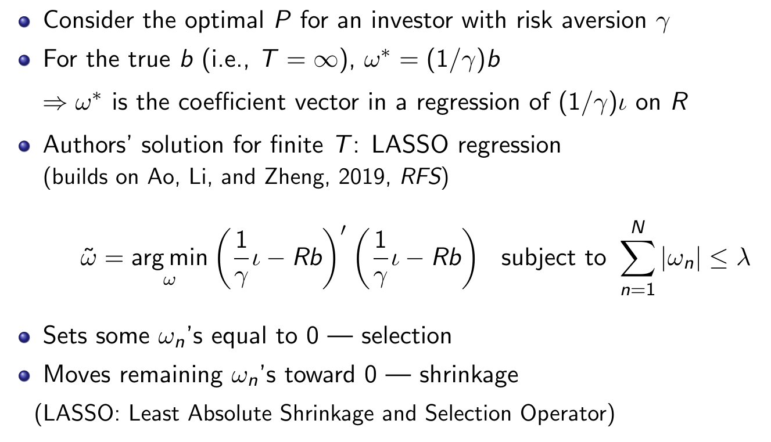
LASSO solution

Slide 13
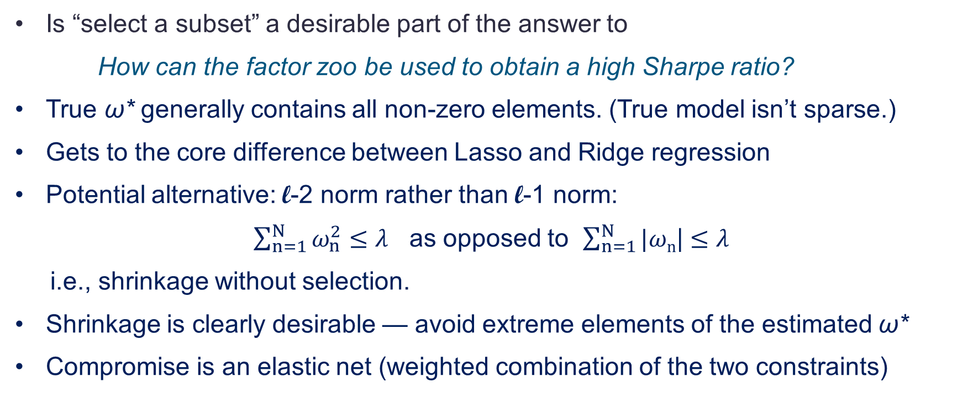
Selection vs. shrinkage
Is “select a subset” a desirable part of the answer to
How can the factor zoo be used to obtain a high Sharpe ratio?
True ω* generally contains all non-zero elements. (True model isn’t sparse.)
Gets to the core difference between Lasso and Ridge regression
Potential alternative: l-2 norm rather than l-1 norm:
$\sum_{n=1}^{N}{ω_{n}^{2}}$ $≤$ $λ$ as opposed to $\sum_{n=1}^{N}{|ωn}$| $≤$ $λ$
i.e., shrinkage without selection.
Shrinkage is clearly desirable — avoid extreme elements of the estimated ω*
Compromise is an elastic net (weighted combination of the two constraints)

Slide 14



Illustration with two assets: l-1 norm
$$ω_{2}$$
$$\left|ω_{1}\right|+\left|ω_{2}\right| ≤λ$$
$$ω_{1}$$

Slide 15



Illustration with two assets: l-2 norm
$$ω_{2}$$
$$ω_{1}^{2}+ω_{2}^{2} ≤λ$$
$$ω_{1}$$

Slide 16
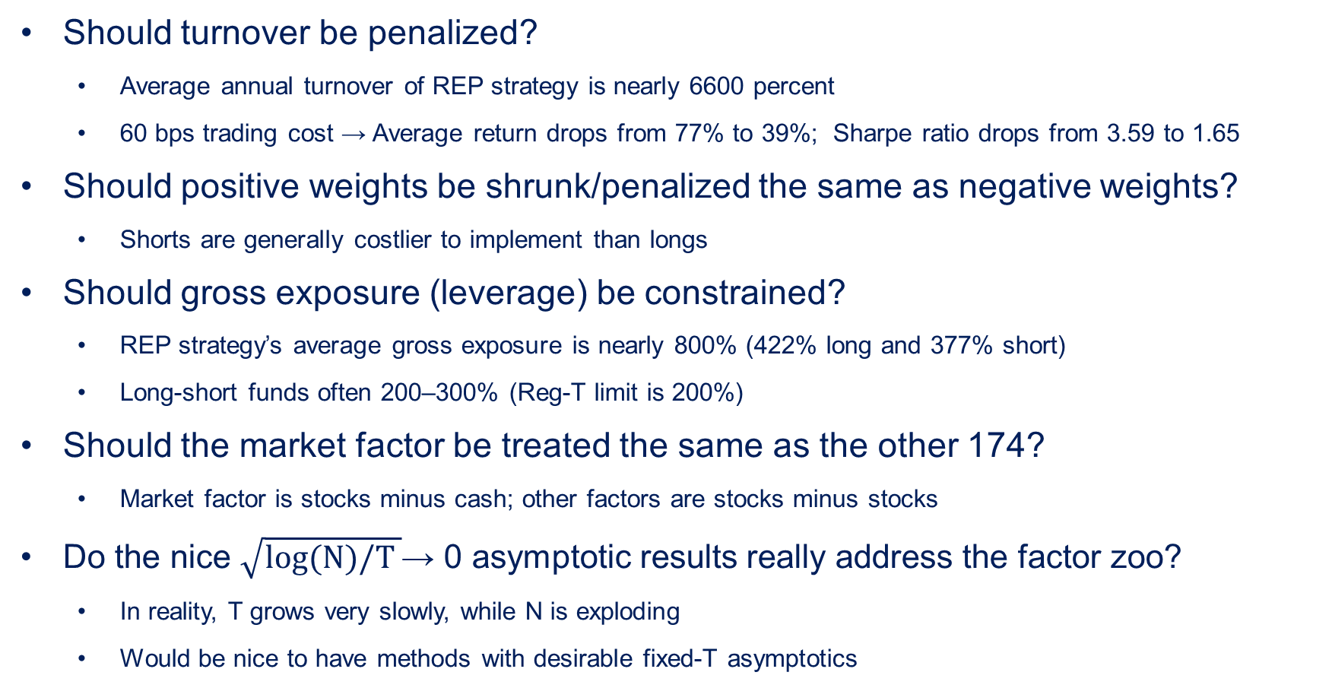
Additional methodology questions
Should turnover be penalized?
Average annual turnover of REP strategy is nearly 6600 percent
60 bps trading cost → Average return drops from 77% to 39%; Sharpe ratio drops from 3.59 to 1.65
Should positive weights be shrunk/penalized the same as negative weights?
Shorts are generally costlier to implement than longs
Should gross exposure (leverage) be constrained?
REP strategy’s average gross exposure is nearly 800% (422% long and 377% short)
Long-short funds often 200–300% (Reg-T limit is 200%)
Should the market factor be treated the same as the other 174?
Market factor is stocks minus cash; other factors are stocks minus stocks
Do the nice $\sqrt{log(N)/T }$→ 0 asymptotic results really address the factor zoo?
In reality, T grows very slowly, while N is exploding
Would be nice to have methods with desirable fixed-T asymptotics

Slide 17
In closing
Which factors matter? Not so clear, beyond “many”
Intriguing investment use of the factor zoo
Refines and extends the regularized regression approach
Nice empirical results—wins the paper’s Sharpe ratio tournament
Potential for further extensions
Bond factors
Novel result: do not help price equities in the presence of the equity factor zoo
Are priced in part by equity factors, confirming earlier evidence

