Slide 1
Money Management and
Real Investment by Gervais & Strobl
Discussion by David Musto

Slide 2


Slide 3


Slide 4
Marriott raising money on Apr 14, 2020
8:47AM: Looking for $1BB, 5yr, ~7.25%
  Baa3/BBB-, step-up if ↓ junk
11:15AM: 6%?
3:01PM: $1.6BB 5yr @ 5.75%

Slide 5
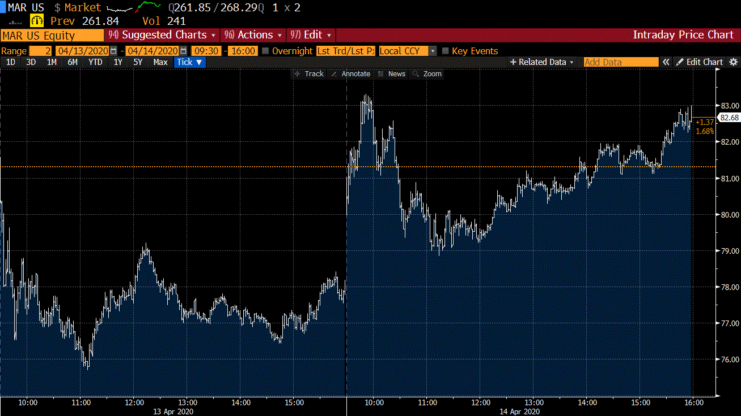

Slide 6
This model
Analyst knows what companies should do
  Sells the info to measure-zero, price-taking investors
  Noise provided by hedging motive
  Analyst calibrates trade to noise with price f charged for info, via endogenous fraction λ of non-hedgers who buy it
  Companies learn some of what analyst knows and adjust accordingly
    Feeds back into return
Transmission of useful info to companies through market price via profit-maximizing sale to investors

Slide 7
Not
Index vs active
  Born indexing, sell it all to risk-neutral market maker
Wisdom of crowds
  Monopolist source of information
Principal/Agent problem

Slide 8
Maximizing profit from info
Sell it (or actively manage)
Activism – buy a stake and make your case
PE – buy it all, do your thing, sell
Why is it common knowledge that you know the right thing and the company doesn’t?
  Why should you be honest?
  Do they know it and just won’t do it? Why?

Slide 9
Where does learning from prices actually fit in?
When is this how outside research affects production?
Debt markets
  Much more likely source of funding for new investment
  High-dimensional contract to negotiate
  Credit committees
  Revise spread & size

Slide 10
So
Impressive extension of GS
  Information getting into production through optimal trading
Lots of ways to affect production by public companies
  Seem to be losing faith in this one
What does this tell us about
  How we should expect analysts to profit from information?
  How could information be better directed to its best use?
Thanks!

